Slide 1

Social Media Bets
Developers:
Lucas Manning
Alejandra Vasquez
Sarah Kang

Slide 2


Unfair Comparisons and Partial Pictures: T There is no one-size-fits-all
Unfair Comparisons:
Art: Jackson Pollock v Leonardo DaVinci (who’s better)
Music: Mozart v Beyonce
Politics: One party isn’t for everyone
Partial Pictures:
Personality Tests
Grand Unified Theory (The sciences)
Does this stop us? Of course not. And it shouldn’t…but can we do better?

Slide 3

Customized Recommendations: Because Not All Companies Are The Same
The answer: YES! Let’s stop treating the marketing like one method works, or that every industry or company is not distinct.
Our system begins by evaluating potential return on investment running multiple strategic models, ultimately choosing the model that will generate the highest return for the investor.
Additionally, we are introducing metrics like social sentiment analysis to capture the ever-growing diversity of companies, investors, and the market as a whole.

Slide 4
Thesis
Public Sentiment indicator of stock price?
Is there a correlation between social media activity vs. price?
Can we add alpha from these trades?

Slide 5



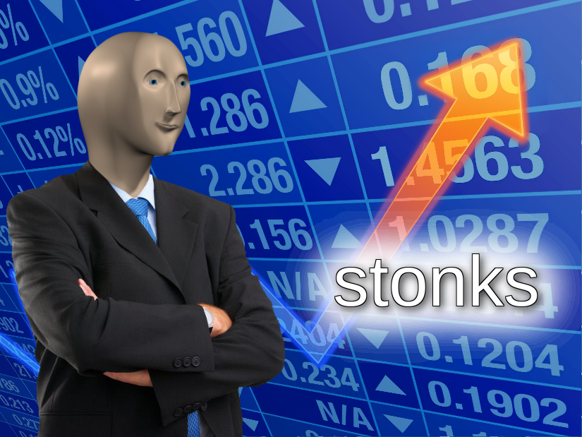



API / Research
Test various stocks
Test various time periods
Test for accuracy
Scrape Social Media - Twitter, Reddit, news articles
Evaluate number of posts, likes, shares
Evaluate the sentiment of these posts of activity on social media

Slide 6
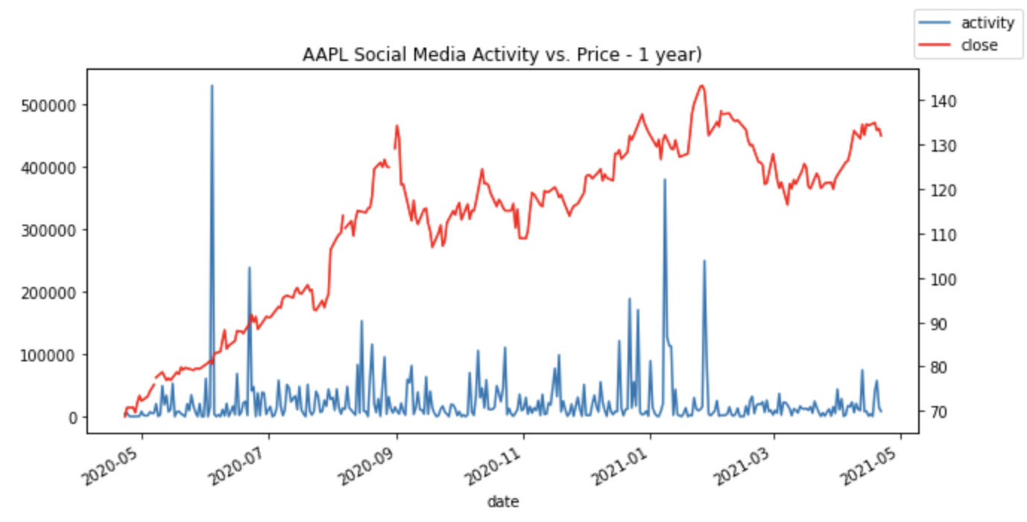
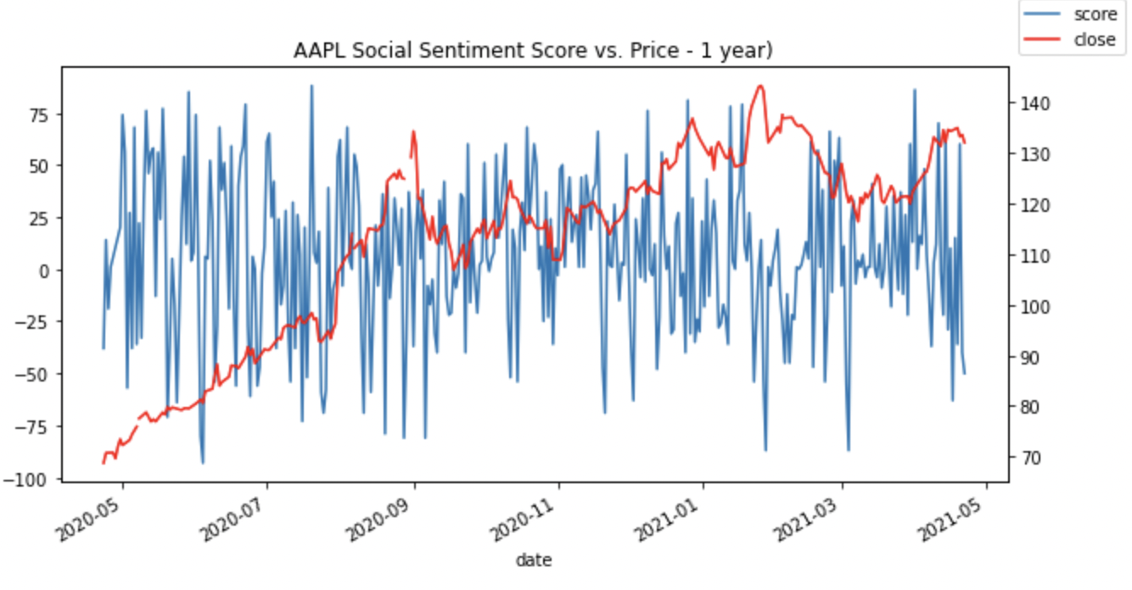
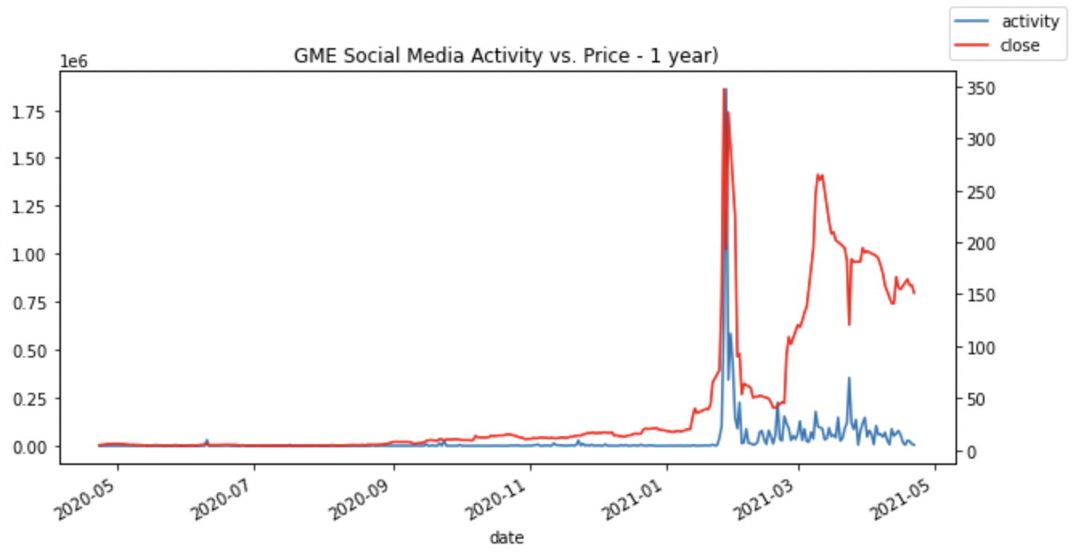
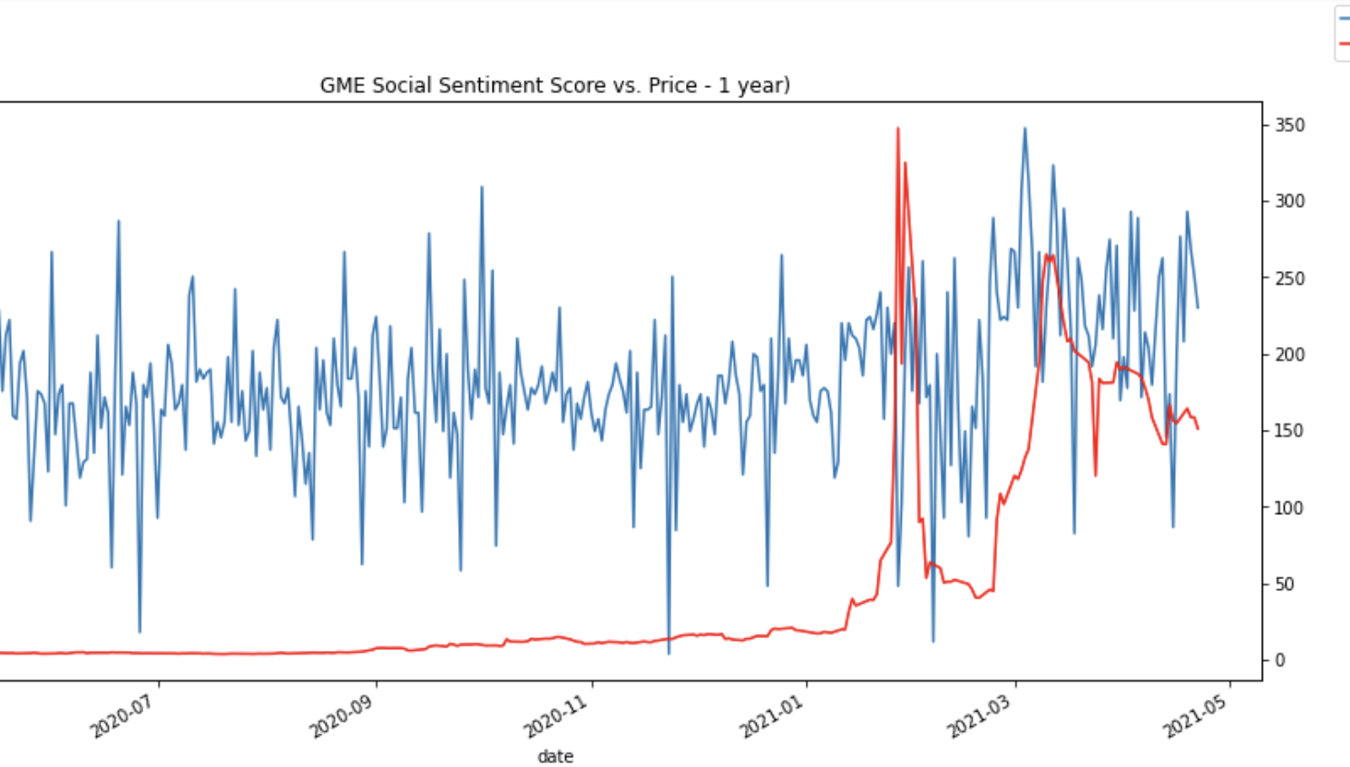
Analysis / Data Input
Social Media Activity – continuous (0 to infinity)
Price – continuous (0 to infinity)
Social Score - range -100 to +100

Slide 7
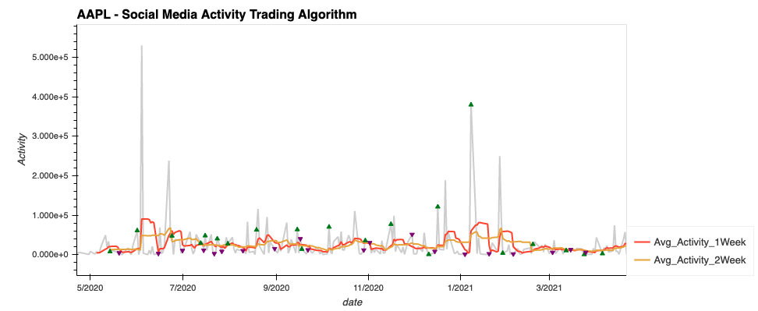
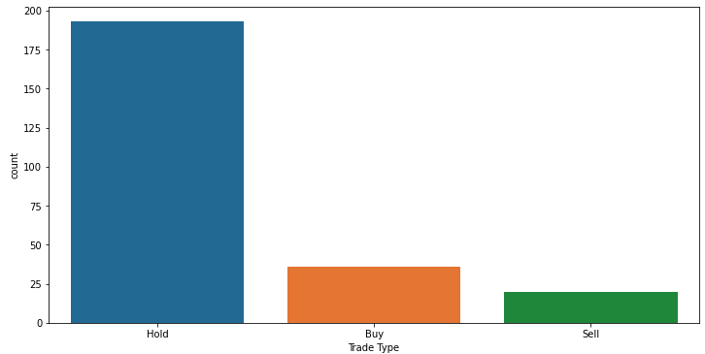
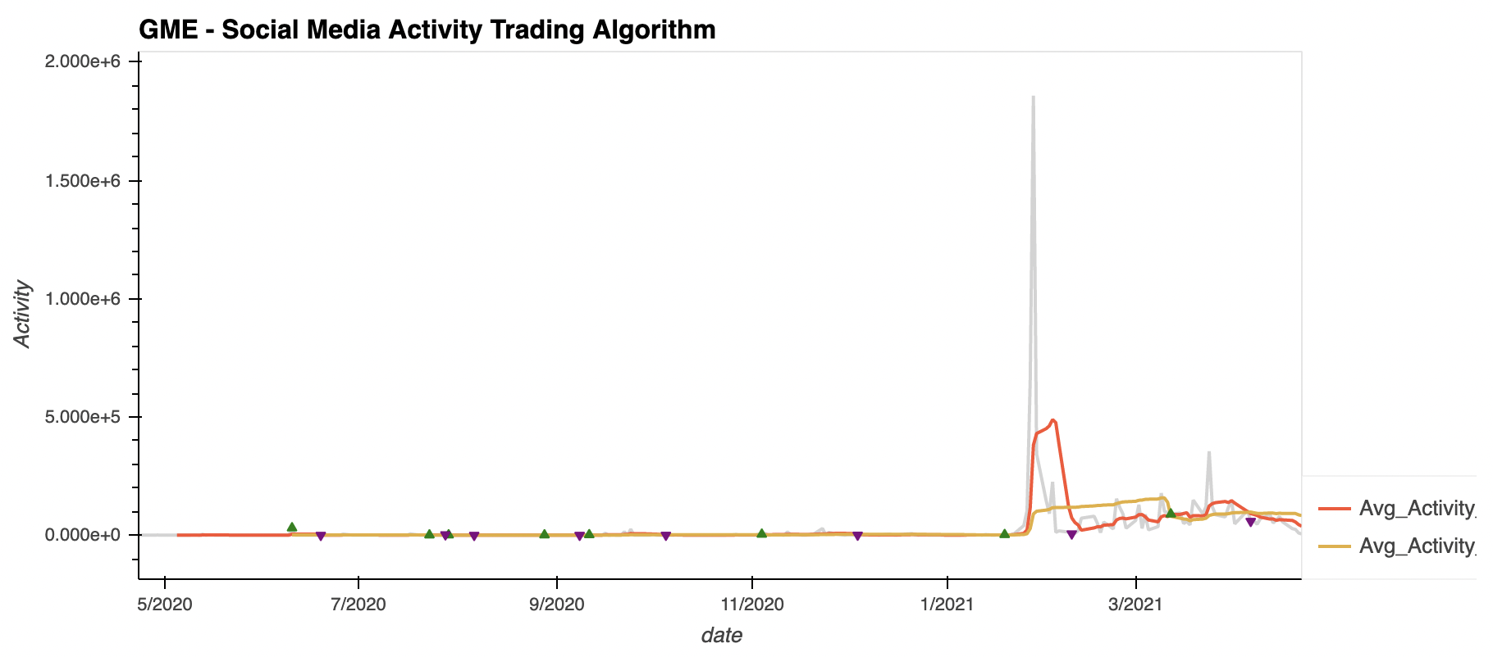
Output / Result
Buy/Sell Criteria (Contrarian Indicator)
Moving Average of Social Media Activity
Social Media Score
Score < -50 = Buy
Score > 50 = Sell
Results:
Some stocks show less correlation between public sentiment and price (ie. AAPL) whereas some stock show stronger correlation at times (i.e GME)
External factors: seasonal (earnings season, product launch), lack of media presence

Slide 8
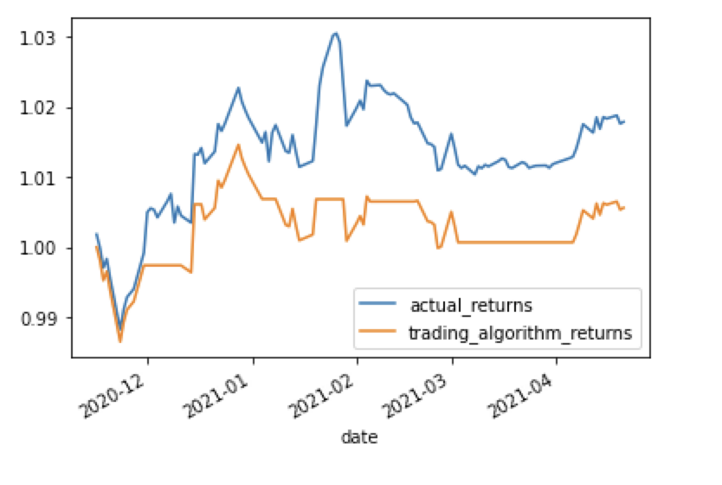
Trading with Machine Learning
We incorporate intelligence and automation into our trading strategies by using machine learning.
Machine learning systems can evaluate multiple factors that influence investment decisions (such as social sentiment and daily returns) even more efficiently than humans—resulting in more accurate trading decisions.

Slide 9
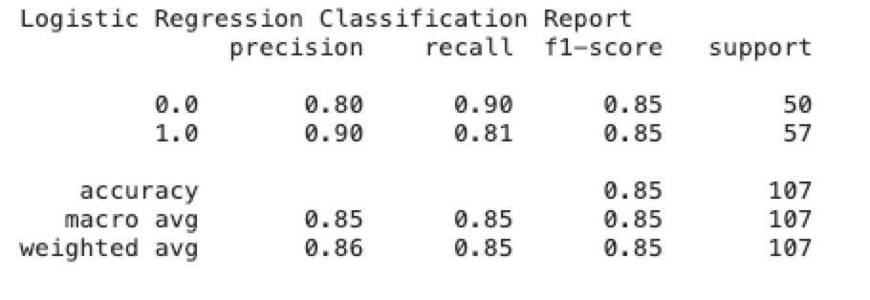
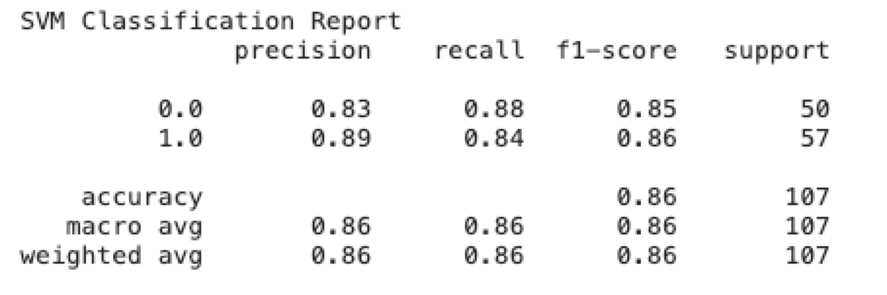
Accuracy = Profits
Choosing a machine learning model to use in a trading strategy is a matter of trial and error.
The report shows us that the Logistic regression model reports a 86% --higher accuracy report compared to the SVM model at 85% percent.

Slide 10

Q&A

